Slide 1
Networks Introduction
Modeling practical lab 2

Slide 2
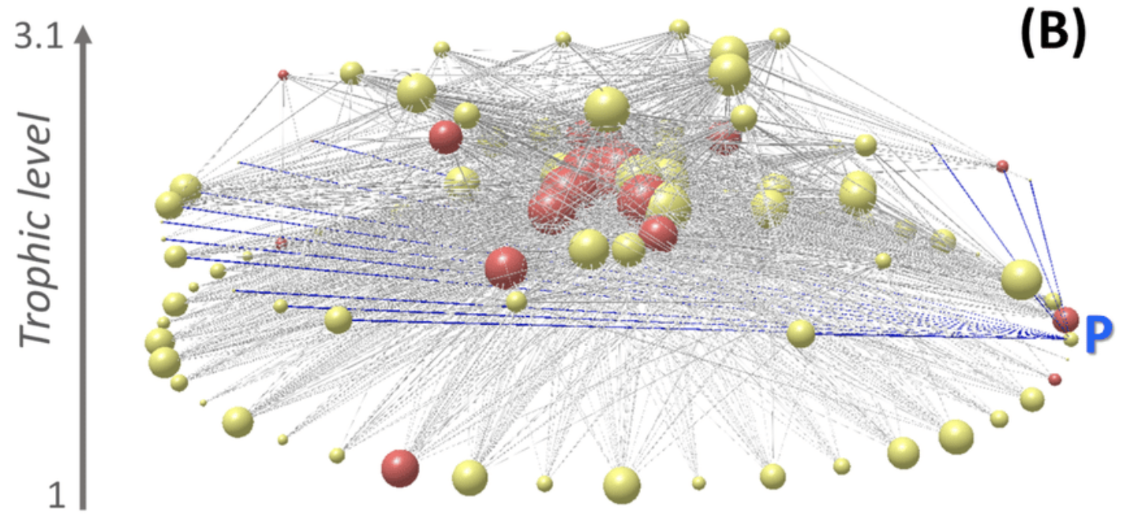
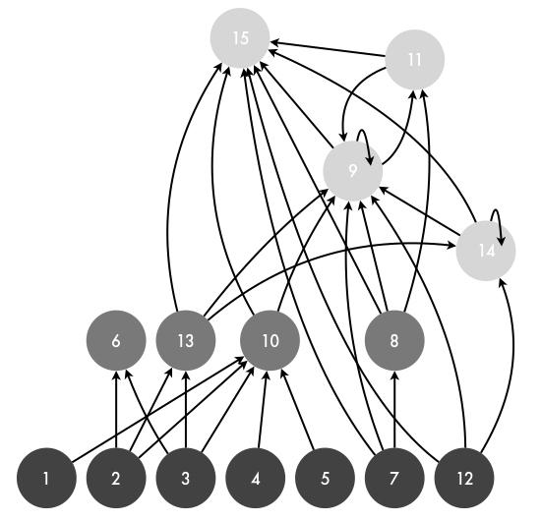
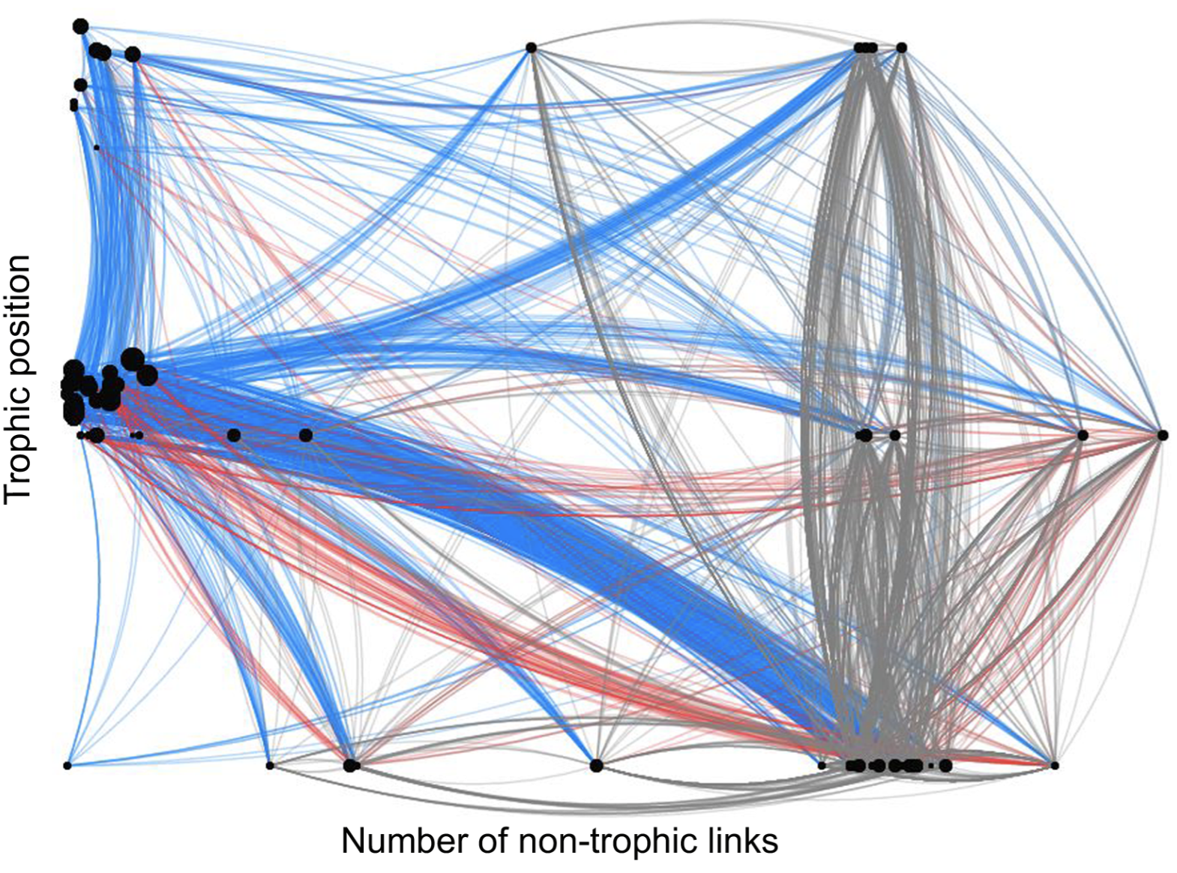
The networks we may be used to seeing… (graphical)

Slide 3
Understanding graphical networks
consumer/predator
Energy flows from the beginning of the arrow (starting at the resource) to the end of the arrow’s point (ending at the consumer)
Questions?
resource/prey

Slide 4
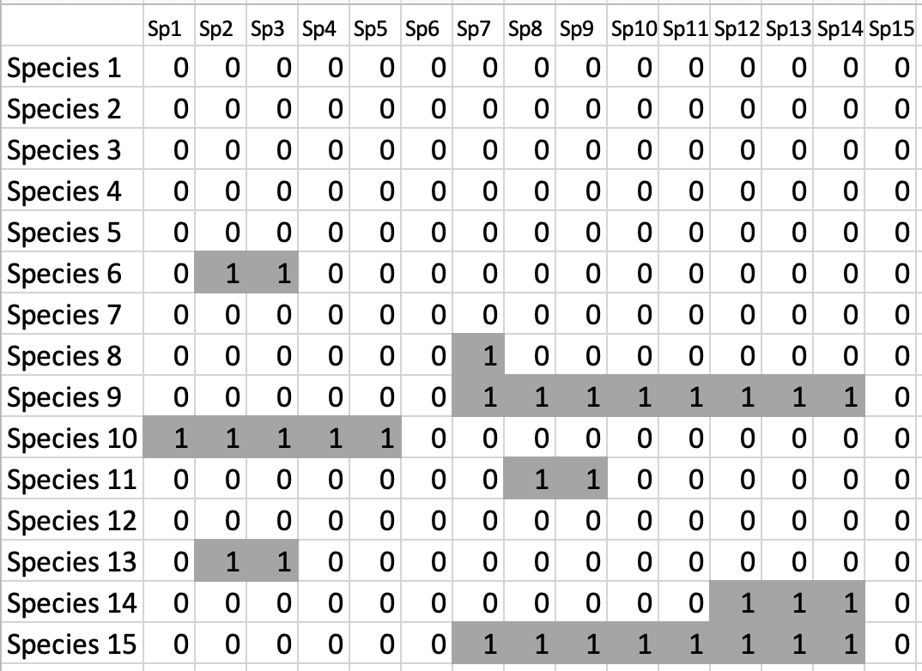
Conversion between Graphical and Matrix forms
Matrix form is used in the code

Slide 5
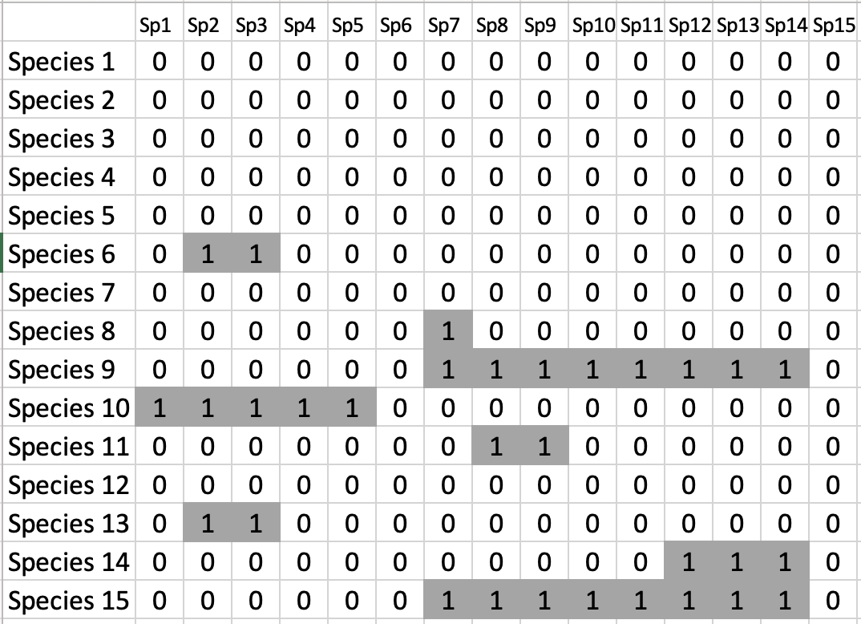
Each species, x, has a row and column

Slide 6
Row = resources of species x
ROWS, RESOURCES BOTH START WITH THE LETTER R ☺

Slide 7
Column = consumers of species x
COLUMNS, CONSUMERS BOTH START WITH THE LETTER C ☺

Slide 8
Check for understanding
Draw the graphical network from the given matrix
Sp. 1
Sp. 2
Sp. 3
Sp. 4
Sp. 5
?
Sp. 1
 |  | 1
1 |  | 1 | 1
 | 1 | 1
 |  |  |  | 1
1 | 1
Sp. 2
Sp. 3
Sp. 4
Sp. 5
Remember:
Rows eat columns

Slide 9
Network Topology Slides (Isidora)

Slide 10
How can we study food webs?
Recognizing the food web structure and complexity (Topology)

Slide 11
How can we study food webs?
Recognizing the food web structure and complexity (Topology)
Sp.6
Structural Properties:
Number of nodes (S)
Number of links (L)
Connectance ( C = L/S²)
Vulnerability
Generality
Numbers of trophic levels
Proportion of basal, intermediate, top species
Proportion of omnivores
Sp.4
Sp.5
Sp.1
Sp.2
Sp.3
Avila-Thieme et al. 2021

Slide 12
How can we study food webs?
Recognizing the food web structure and complexity (Topology)
Sp.6
Structural Properties:
Number of nodes (S)
Number of links (L)
Connectance (C = L/S²)
Vulnerability
Generality
Numbers of trophic levels
Proportion of basal, intermediate, top species
Proportion of omnivores
Sp.4
Sp.5
Sp.1
Sp.2
Sp.3
Avila-Thieme et al. 2021

Slide 13
How can we study food webs?
Recognizing the food web structure and complexity (Topology)
Sp.6
Structural Properties:
Number of nodes (S)
Number of links (L)
Connectance (C = L/S²)
Vulnerability, mean and SD
Generality, mean and SD
Numbers of trophic levels
Proportion of basal, intermediate, top species
Proportion of omnivores
Sp.4
Sp.5
Sp.1
Sp.2
Sp.3
Avila-Thieme et al. 2021

Slide 14
How can we study food webs?
Recognizing the food web structure and complexity (Topology)
Sp.6
Structural Properties:
Number of nodes (S)
Number of links (L)
Connectance ( C = L/S²)
Vulnerability
Generality
Numbers of trophic levels
Proportion of basal, intermediate, top species
Proportion of omnivores
Sp.4
Sp.5
Sp.1
Sp.2
Sp.3
Avila-Thieme et al. 2021

Slide 15
How can we study food webs?
Recognizing the food web structure and complexity (Topology)
Sp.6
Structural Properties:
Number of nodes (S)
Number of links (L)
Connectance ( C = L/S²)
Vulnerability
Generality
Numbers of trophic levels
Proportion of basal, intermediate, top species
Proportion of omnivores
Sp.4
Sp.5
Sp.1
Sp.2
Sp.3
Avila-Thieme et al. 2021
Notes:
Here we have a toy food web of 6 nodes. The structural properties tell as how complex the network is. Here the most common index are this ones
In the case of

Slide 16
How can we study food webs?
Recognizing the food web structure and complexity (Topology)
Sp.6
Structural Properties:
Number of nodes (S)
Number of links (L)
Connectance ( C = L/S²)
Vulnerability
Generality
Numbers of trophic levels
Proportion of basal, intermediate, top species
Proportion of omnivores
Sp.4
Sp.5
Mean and SD
Sp.1
Sp.2
Sp.3
Avila-Thieme et al. 2021
Notes:
Here we have a toy food web of 6 nodes. The structural properties tell as how complex the network is. Here the most common index are this ones
In the case of

Slide 17
How can we study food webs?
Recognizing the food web structure and complexity (Topology)
Sp.6
Structural Properties:
Number of nodes (S)
Number of links (L)
Connectance ( C = L/S²)
Vulnerability, mean and SD
Generality, mean and SD
Numbers of trophic levels
Proportion of basal, intermediate, top species
Proportion of omnivores
Sp.4
Sp.5
Sp.1
Sp.2
Sp.3
Avila-Thieme et al. 2021

Slide 18
How can we study food webs?
Recognizing the food web structure and complexity (Topology)
Sp.6
Structural Properties:
Number of nodes (S)
Number of links (L)
Connectance ( C = L/S²)
Vulnerability, mean and SD
Generality, mean and SD
Numbers of trophic levels
Proportion of basal, intermediate, top species
Proportion of omnivores
Sp.4
Sp.5
Sp.1
Sp.2
Sp.3
Avila-Thieme et al. 2021

Slide 19
How can we study food webs?
Recognizing the food web structure and complexity (Topology)
Sp.6
Structural Properties:
Number of nodes (S)
Number of links (L)
Connectance ( C = L/S²)
Vulnerability, mean and SD
Generality, mean and SD
Numbers of trophic levels
Proportion of basal, intermediate, top species
Proportion of omnivores
Sp.4
Sp.5
Sp.1
Sp.2
Sp.3
Avila-Thieme et al. 2021

Slide 20
How can we study food webs?
Recognizing the food web structure and complexity (Topology)
Sp.6
Structural Properties:
Number of nodes (S)
Number of links (L)
Connectance ( C = L/S²)
Vulnerability, mean and SD
Generality, mean and SD
Numbers of trophic levels
Proportion of basal, intermediate, top species
Proportion of omnivores
Sp.4
Sp.5
Sp.1
Sp.2
Sp.3
We can compare the food web topology with and withouth perturbations to see how it’s changes
Avila-Thieme et al. 2021

Slide 21
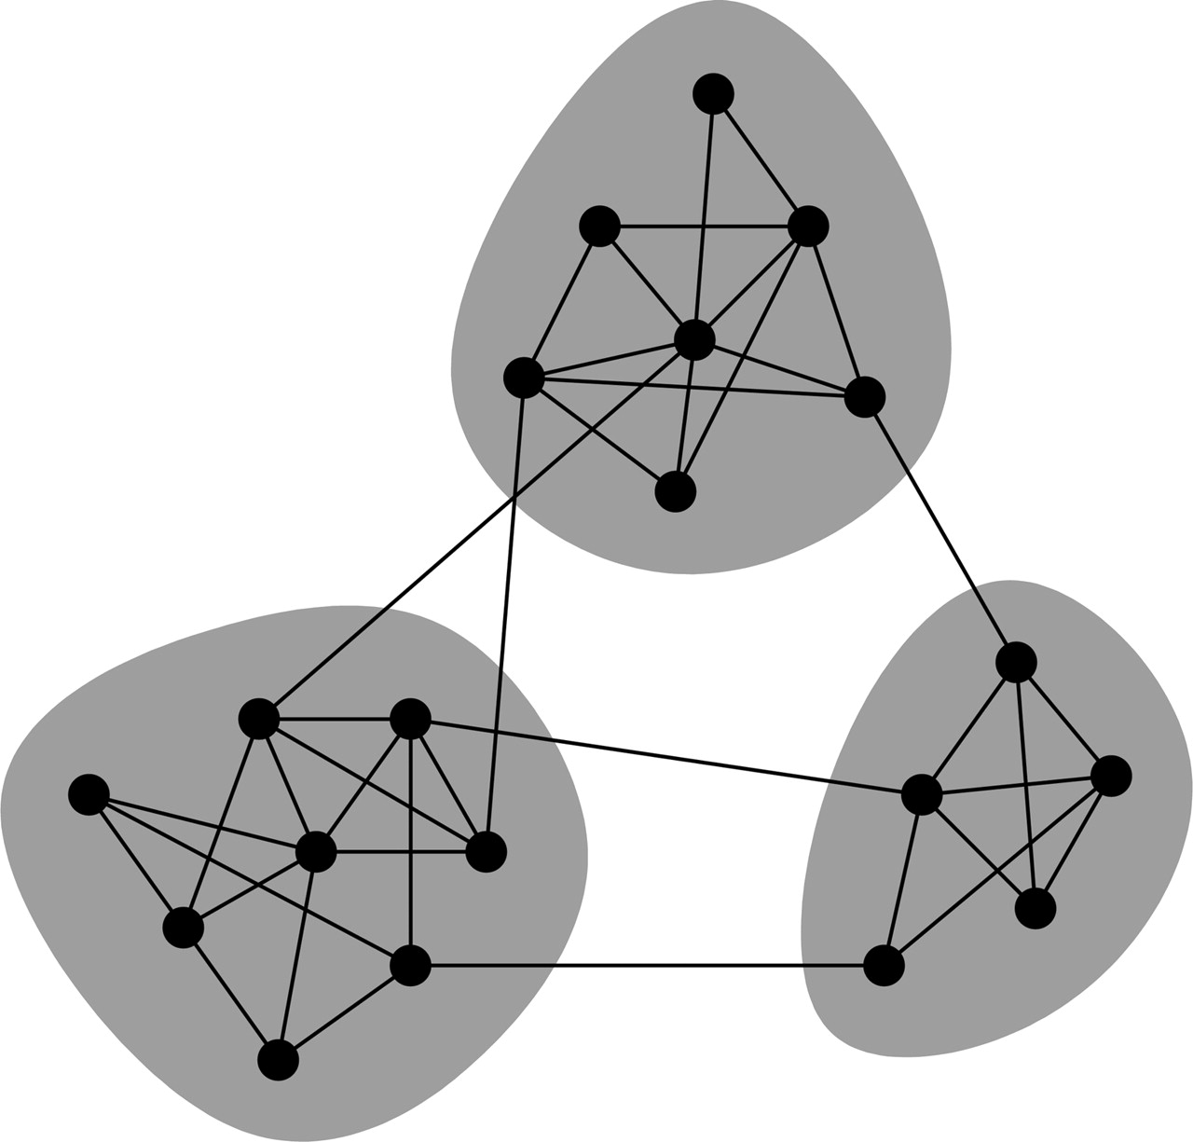
How can we study food webs?
Understanding how robust the food web is to perturbations
Structural Properties:
Number of nodes (S)
Number of links (L)
Connectance ( C = L/S²)
Vulnerability, mean and SD
Generality, mean and SD
Numbers of trophic levels
Proportion of basal, intermediate, top species
Proportion of omnivores and canibalism
Functional Properties:
Modularity
Degree distribution
Avila-Thieme et al. 2021

Slide 22
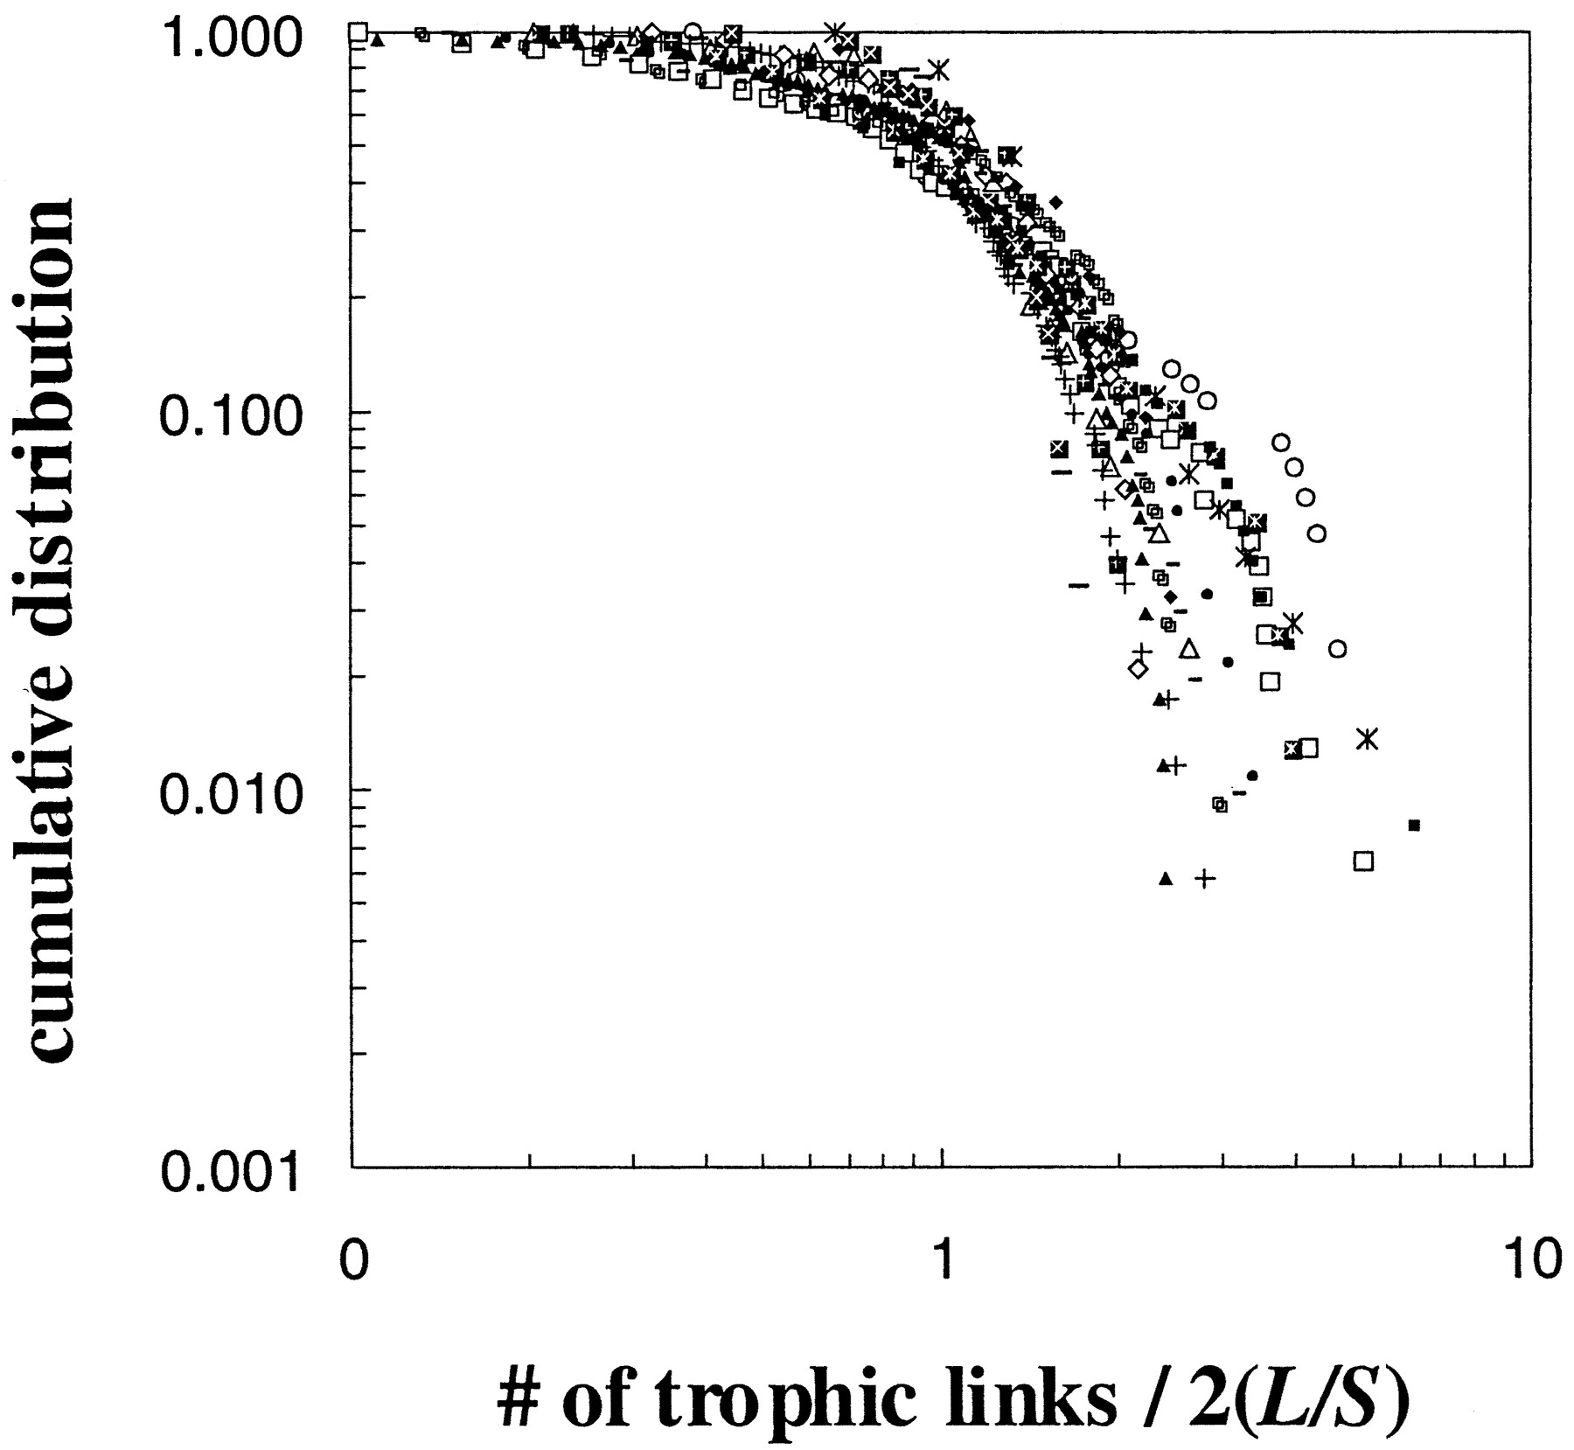
How can we study food webs?
Understanding how robust the food web is to perturbations
Structural Properties:
Number of nodes (S)
Number of links (L)
Connectance ( C = L/S²)
Vulnerability, mean and SD
Generality, mean and SD
Numbers of trophic levels
Proportion of basal, intermediate, top species
Proportion of omnivores and canibalism
Functional Properties:
Modularity
Degree distribution
Avila-Thieme et al. 2021

